Slide 1
Using Voltage Regulators to Power Your Projects
Bret Stateham
Bret.Stateham@microsoft.com
@BretStateham
http://channel9.msdn.com/niners/BretStateham

Slide 2
Agenda

Slide 3
What is a voltage regulator?
A Voltage Regulator is a component in a system that is designed to maintain or “regulate” a constant output voltage given certain parameters.

Slide 4
SO WHAT?

Slide 5
UNREGULATED POWER SUPPLIES THAT’S WHAT!

Slide 6
OH, AND PROJECTS WITH MULTIPLE VOLTAGE AND POWER REQUIREMENTS TOO!

Slide 7
SO THERE!

Slide 9
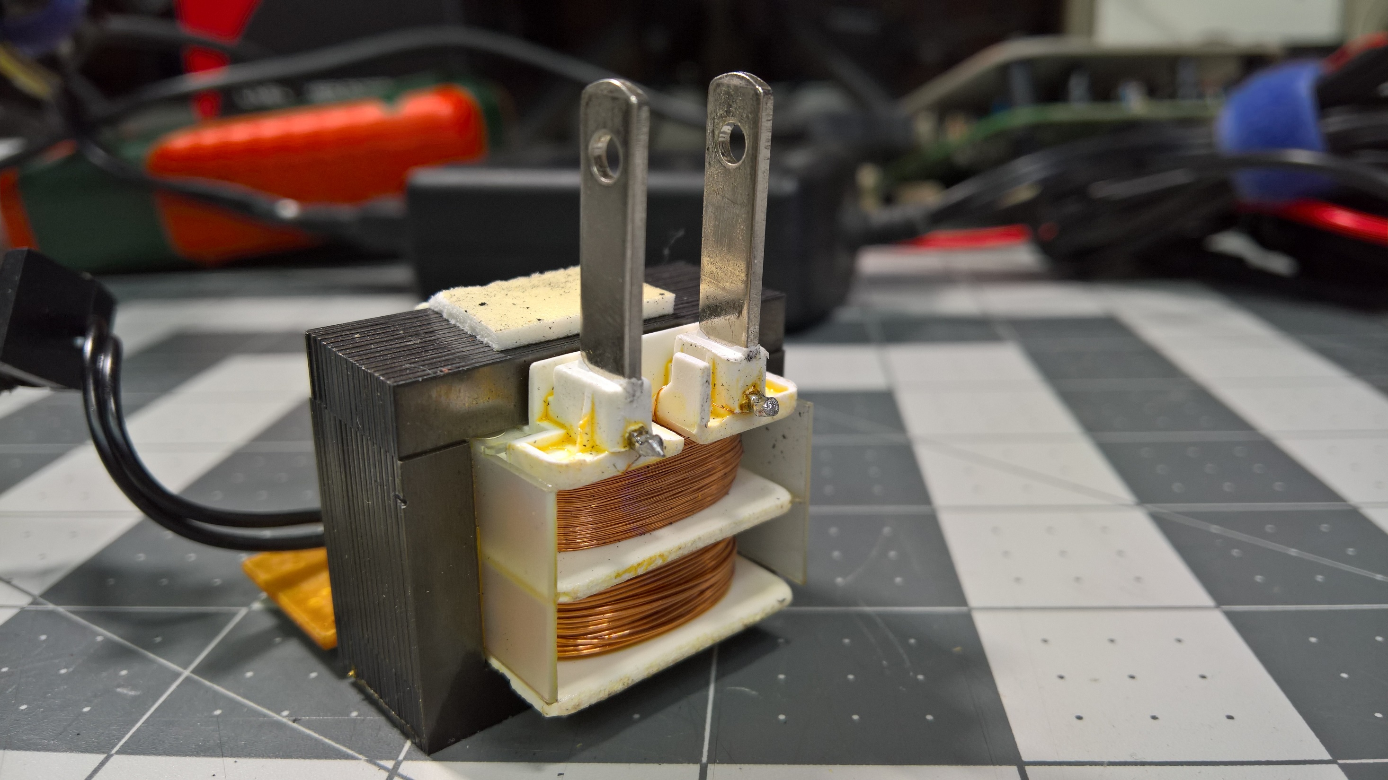
Step-Down AC Transformer
Solid Core
Primary Coil
Secondary Coil

Slide 10
Step-Down AC Transformer
Solid Core

Slide 11
Step-Down AC Transformer
Solid Core

Slide 12
Step-Down AC Transformer
Solid Core
Primary Coil
Secondary Coil

Slide 13
Step-Down AC Transformer
Primary Coil – Has more windings
AC Output voltage will be lower than AC Input voltage because the secondary coil has fewer windings.
AC INPUT
AC OUTPUT
Secondary Coil – Has fewer windings

Slide 14
Step-Down AC Transformer
Primary Coil – Has more windings
AC Output voltage will be lower than AC Input voltage because the secondary coil has fewer windings.
AC INPUT
AC OUTPUT
Secondary Coil – Has fewer windings

Slide 15
diodes
A Diode is a semi-conductor that only allows current to flow from it’s “Anode” to it’s “Cathode”
Anode
Cathode
1N4007

Slide 16
diodes
“Forward Biased” - Current can flow
+V
-V
Anode
Cathode
1N4007

Slide 17
diodes
“Reverse Biased” – Current can NOT flow
-V
+V
Anode
Cathode
1N4007

Slide 18
HALF-WAVE RECTIFICATION
+V
+V
AC INPUT
R_{LOAD}
0V
0V
AC
DC

Slide 19
HALF-WAVE RECTIFICATION
AC INPUT
R_{LOAD}

Slide 20
HALF-WAVE RECTIFICATION
Diode is “Forward Biased” so current flows
+V
+V
AC INPUT
R_{LOAD}
0V
0V
AC
DC

Slide 21
HALF-WAVE RECTIFICATION
Diode is “Forward Biased” so current flows
+V
+V
AC INPUT
R_{LOAD}
0V
0V
AC
DC

Slide 22
HALF-WAVE RECTIFICATION
Diode is “Reverse Biased” so NO current flows
0V
AC INPUT
R_{LOAD}
+V
AC
DC

Slide 23
HALF-WAVE RECTIFICATION
Diode is “Forward Biased” so NO current flows
0V
0V
AC INPUT
R_{LOAD}
+V
0V
AC
DC

Slide 24
HALF-WAVE RECTIFICATION
+V
AC INPUT
R_{LOAD}
0V
DC
Average
AC
DC

Slide 25
AC-DC full wave Bridge rectifier
+V
AC INPUT
DC OUPUT
0V

Slide 26
AC-DC full wave Bridge rectifier
+V
AC INPUT
DC OUPUT
0V

Slide 27
AC-DC full wave Bridge rectifier
+V
+V
+V
AC INPUT
0V
DC OUPUT
+V
0V
0V
AC
DC

Slide 28
AC-DC full wave Bridge rectifier
+V
+V
+V
AC INPUT
0V
DC OUPUT
0V
0V
AC

Slide 29
AC-DC full wave Bridge rectifier
+V
+V
+V
AC INPUT
0V
DC OUPUT
0V
0V
AC

Slide 30
AC-DC full wave Bridge rectifier
+V
+V
+V
AC INPUT
0V
DC OUPUT
+V
0V
0V
AC

Slide 31
AC-DC full wave Bridge rectifier
+V
+V
+V
AC INPUT
0V
DC OUPUT
0V
0V
AC
DC

Slide 32
AC-DC full wave Bridge rectifier
0V
+V
AC INPUT
0V
DC OUPUT
+V
+V
0V
AC
DC

Slide 33
AC-DC full wave Bridge rectifier
0V
+V
AC INPUT
0V
DC OUPUT
+V
+V
0V
AC
DC

Slide 34
AC-DC full wave Bridge rectifier
0V
+V
AC INPUT
0V
DC OUPUT
+V
+V
0V
AC
DC

Slide 35
AC-DC full wave Bridge rectifier
+V
AC INPUT
DC OUPUT
0V
AC
DC

Slide 36
AC-DC full wave Bridge rectifier
+V
AC INPUT
DC OUPUT
0V
“BUMPY” OUPUT
AC
DC

Slide 37
AC-DC full wave Bridge rectifier
+V
AC INPUT
DC OUPUT
0V
DC AVG
AC
DC

Slide 38
Unregulated power supply
AC-DC Power Supply Input: 120VAC Output: 12VDC / 600ma

Slide 39
Unregulated power supply
Full Wave Bridge Rectifier

Slide 40
Unregulated power supply ISSUES
The “Output” voltage rating is a LIE!
Ok, not a “lie”, but it is rarely factual. Why?
When there is no load, or a load that requires less than the rated amperage, the voltage will be much higher.
Also, changes or spikes in the input AC, or the DC load will cause the voltage to change.
Finally, there will always be some “Ripple” in the output DC under load due to the AC component in the voltage.
AC-DC Power Supply Input: 120VAC Output: 12VDC / 600ma

Slide 41
REGULATED DC POWER SUPPLY
+V
AC INPUT
DC OUPUT
0V

Slide 43
VOLTAGE REGULATOR

Slide 44
IoT Logo

Slide 45
arduino

Slide 46
GALILEO BOARD

Slide 47
RASPBERRY PI

Slide 48
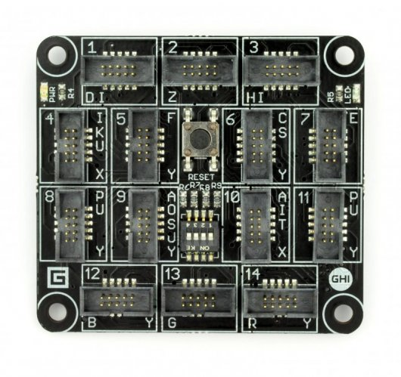
FEZ SPIDER MAIN BOARD

Slide 49
Sparkfun weather shield

Slide 50
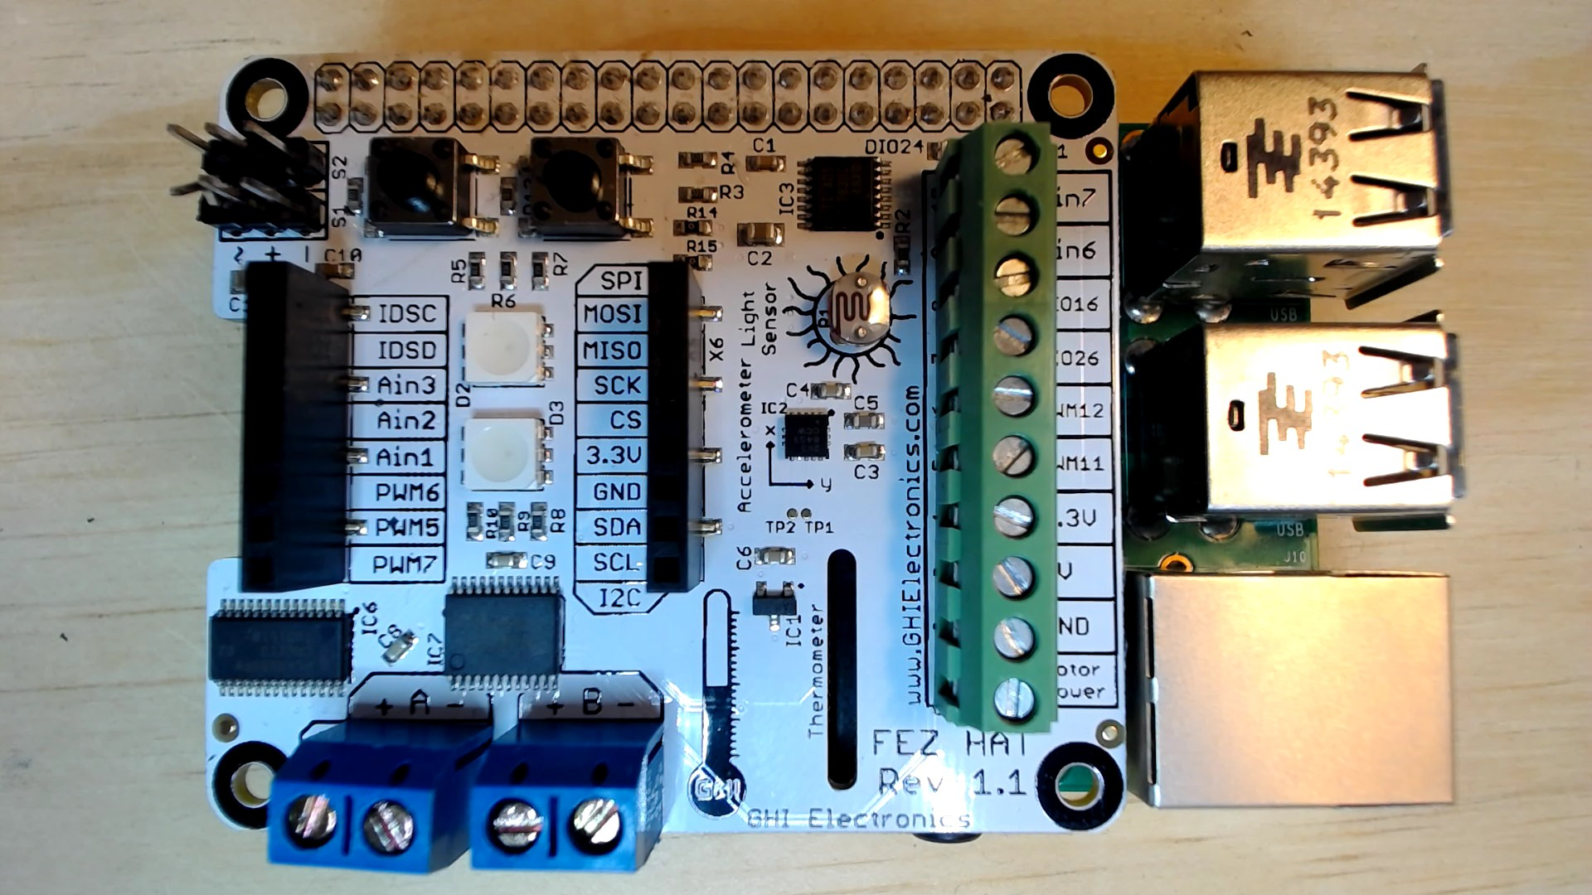
FEZ HAT

Slide 51
Connect the dots azure icons
Event Hubs
Stream Analytics
Storage
(
Azure
Microsoft Azure
Web App
Service Bus
)
Storage blob
Storage table
SQL database
HDInsight
Machine
(
Learning
GitHub code
Git repository
generic
)

Slide 52
LEDs

Slide 53
Resistors
220Ω
1st Digit
2nd Digit
Multiplier
Tolerance
Color | Name | 1st Digit | 2nd Digit | Multiplier | Tolerance
 | Black | 0 | 0 | X1
 | Brown | 1 | 1 | X10 | 1%
 | Red | 2 | 2 | X100
 | Orange | 3 | 3 | X1,000
 | Yellow | 4 | 4 | X10,000
 | Green | 5 | 5 | X100,000
 | Blue | 6 | 6 | X1,000,000
 | Violet | 7 | 7
 | Grey | 8 | 8
 | White | 9 | 9
 | Gold |  |  | X0.1 | 5%
 | Silver |  |  | X0.01 | 10%
330Ω
10KΩ

Slide 54
cables

Slide 55
More cables and adapters

Slide 56

LEDs
Anode (+)
Cathode (-)
Flat Edge
Small Post
Big Post
Long Leg
Short Leg
Vcc (+)
GND

Slide 57
LEDs

Slide 58
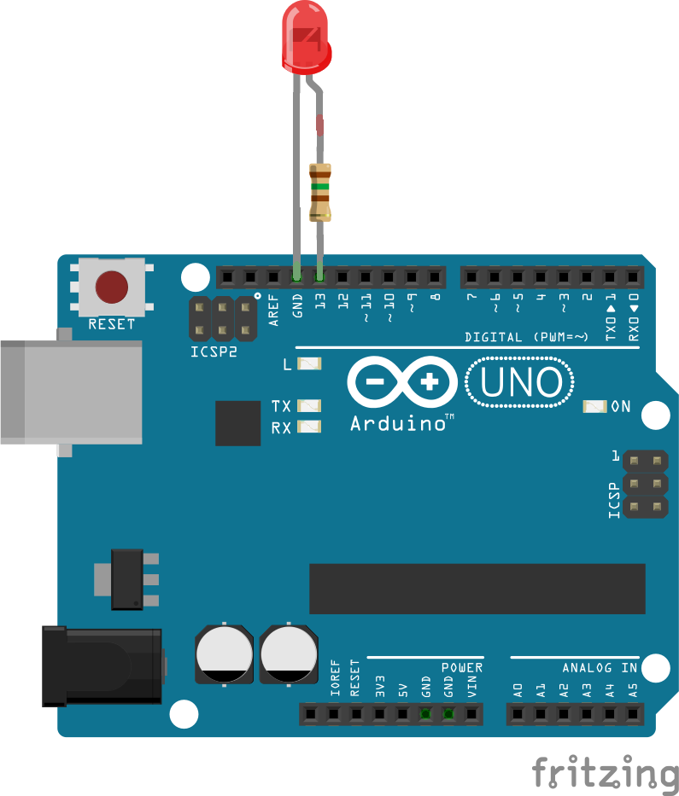


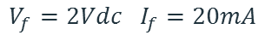
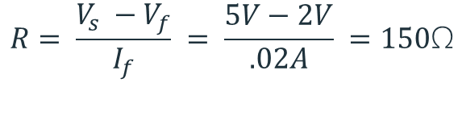
Current limiting resistors
Providing more current than an LED is rated for can destroy the LED. To prevent that, you should use a “Current Limiting” resistor.
To calculate the value of the resistor you need to know the supply voltage (Usually 5V on the Arduino Uno), and the LEDs rated Forward Voltage (the voltage drop across the LED) and Forward Current (the maximum current the LED can handle).
$$V_{f}=2Vdc I_{f}=20mA$$
$$Resistor Value (R)= \frac{Supply Voltage \left(V_{s}\right)−LED Forward Voltage (V_{f}) }{LED Forward Current (I_{f})}$$
$$V_{s}=5Vdc$$
$$R= \frac{V_{s} −V_{f}}{I_{f}} = \frac{5V−2V}{.02A} =150\text{Ω}$$
The Arduino Uno has a built in current limiting resistor on Pin 13. If you use Pin 13 to power your LED you can use it without a separate resistor.

Slide 59
Resistors
220Ω
1st Digit
2nd Digit
Multiplier
Tolerance
Color | Name | 1st Digit | 2nd Digit | Multiplier | Tolerance
 | Black | 0 | 0 | X1
 | Brown | 1 | 1 | X10 | 1%
 | Red | 2 | 2 | X100
 | Orange | 3 | 3 | X1,000
 | Yellow | 4 | 4 | X10,000
 | Green | 5 | 5 | X100,000
 | Blue | 6 | 6 | X1,000,000
 | Violet | 7 | 7
 | Grey | 8 | 8
 | White | 9 | 9
 | Gold |  |  | X0.1 | 5%
 | Silver |  |  | X0.01 | 10%
330Ω
10KΩ

Slide 60
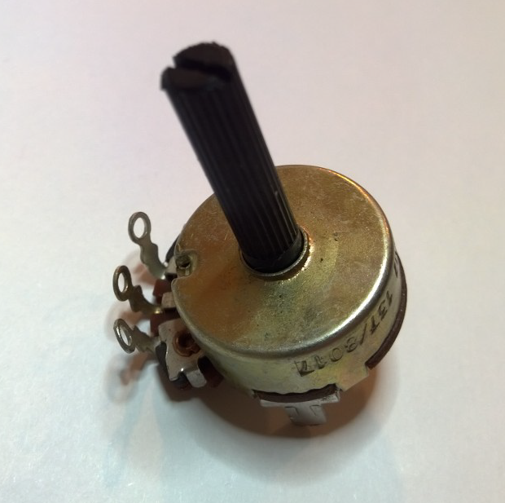
Potentiometer – variable resistor

Slide 61
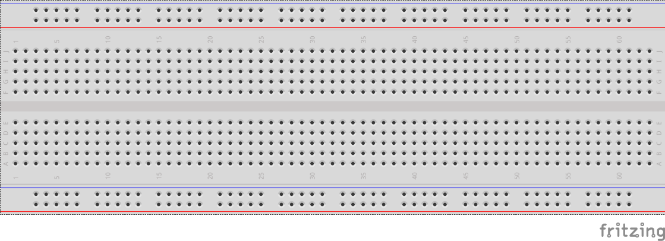
breadboards
Breadboards offer a great way to prototype circuits. The provide a number of “buses” for connecting both power and components.
Power buses run the entire horizontal length
Component buses give you easy ways to connect pins together

Slide 64
Micro SD Cards
Font: Segoe UI Semibold

